Slide 1
Air Force Evolution to Open Avionics
- HPEC 2010 Workshop -
Robert Bond
16 September 2010
Notes:
1
Title Page

Slide 2
Outline
Open Architecture Vision for the Air Force
  Layered architecture
  Technologies
Air Force Avionics Architectures
  F22 Raptor case study
  Architecture evolution
Open Avionics
  Key open avionics concepts
  Architectures and testbeds
Acquisition in an Open Architecture Context
  Leverage and adapt
  “Open” acquisition
Conclusion
Notes:
Outline

Slide 3
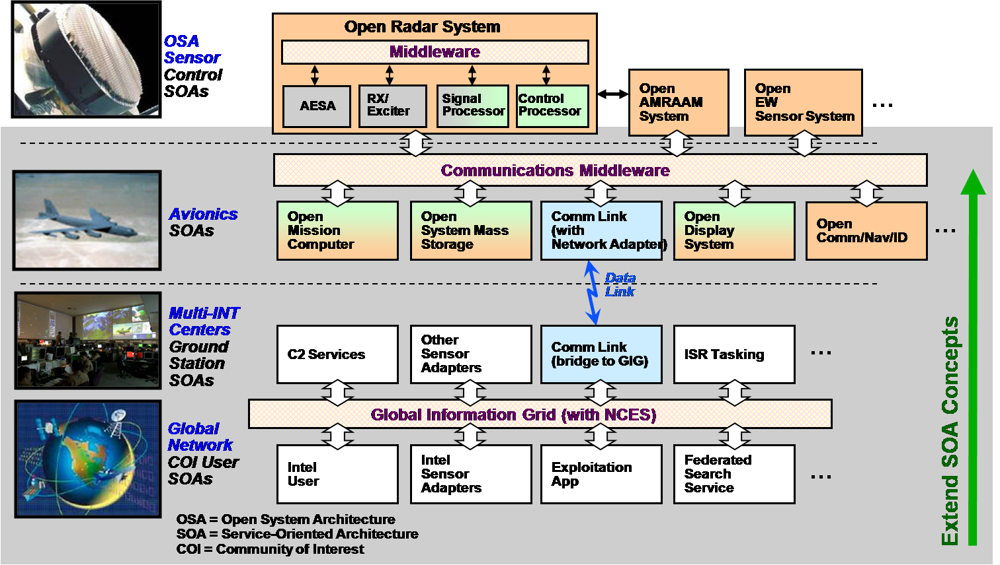
Air Force
Layered Open Systems Architecture (OSA)
Open Sensors
Open Avionics
Net-Centric Systems
VISION: Air Force is developing an integrated (but loosely coupled) open-systems architectures spanning Air Force layered system-of-systems
Notes:
3
Air Force is developing an integrated (but loosely coupled) open-systems architectures spanning Air Force layered system-of-systems

Slide 4
Technology Drivers
- Embedded Systems -
Embedded System
Distributed System
Networked System-of-Systems
Airborne Radar
Avionics
Ground Station
GIG
Component
Attribute
Throughput
~ 1 TOPS
~ 10 GFLOPS
~1s GFLOPS
< 1 GFLOPS
Form-factor
10 GOPS/W
> 100 MFLOPS/W
10s MFLOPS/W
10s MFLOPS/W
Data Rate
~500 GB/s
~ 100 GB/s
~ 10GB/s
< 10GB/s
Latency
~ mSecs
~ 100 mSecs
~ secs
> secs
Note that embedded military systems have challenges that set them apart from distributed and networked systems, but…
Notes:
The computer system drivers for the embedded domain are high throughput, constrained form-factors, high data rates, and low computational latency. GIG based applications, by contrast, do not face these challenges in nearly the same degree, whereas avionics and ground stations fall in between these two extremes.

Slide 5
Technology Drivers
- System-of-systems -
Embedded System
Distributed System
Networked System-of-Systems
Airborne Radar
Avionics
Ground Station
GIG
System
Attribute
Application
Complexity
~10s modes
~100s functions
100s modules
100s Programs
# Components
<10 subsys
10s subsys
100s subsys
1000s nodes
Dynamic
topologies,
users,
content/use
Configurability
Static (design)
redundancy
User select
databases
web content
(semantic)
Data
Complexity
arrays
structures
databases
…distributed and networked military system have their own set of challenges that set them apart from embedded systems; and avionics have elements of both domains.
Notes:
GIG applications, on the other hand, have their own set of challenges, including the need to support 1000’s of users; the need to host 100’s of programs; architectures consisting of 1000s of nodes; dynamic configurability, topology, users entering and leaving the system, and varying content and use; and, perhaps most significantly, very rich data content, including large databases with broad semantic content. None of these requirements is nearly as stressing in the embedded system domain. Once again, avionics and ground stations reside in between these extremes.

Slide 6
Open Systems Technologies
Embedded System
Distributed System
Networked System-of-Systems
Airborne Radar
Avionics
Ground Station
GIG
Performance
(Low Latency)
Embedded OSA
Networked SOA
Hardware
Computation
Hardware
generality
VLSI, FPGA, DSP, multicomputers
workstations, servers, clusters
specialization
Computation
Middleware
SAL, VSIPL, PVTOL, RT-CORBA
Libraries, CORBA, SOA, NCES
Communication
Hardware
FPDP, VME, Myrinet, RapidIO
IP based: Infiniband, GigE, WWW
Communication
Middleware
SMM, (RT)-MPI, RT-CORBA,DDS
DDS, CORBA, JMS, HTTP, SOAP
Domain specific technologies support open architectures in the two domains
SOA = Service Oriented Architecture
OSA = Open System Architecture
Notes:
The trend toward open systems-of-systems depends on technologies from the distributed computing domain, suitably adapted to the real-time requirements of of networked HPEC systems. Avionics are at the intersection of the embedded and networked technology regimes and hence open avionics systems have the opportunity to exploit emerging technologies in both area. Service oriented architecture technologies are emerging as a key enabler of open distributed systems.

Slide 7
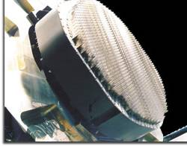
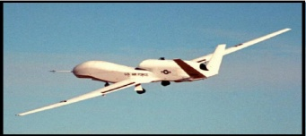
Open Architecture Thrusts
Open Avionics
Open Sensors
Open Avionics
Open Ground Stations
MCE
Ground
Station
GIG
Compatible
Networks
CAOC
Users/Apps
(e.g. Exploitation)
GIG-connected C2ISR users/apps
Sensors → Embedded OSA
Avionics → OSA and SOA blend
Ground Stations → Networked SOA
GIG Users/Apps → Networked SOA
Leverage best of both
SOA = Service Oriented Architecture
OSA = Open System Architecture
Notes:
This chart maps the open system approach (OSA or SOA) to each application area. Note that Avionics are a special case that can exploit and adapt the best of both technology regimes.

Slide 8
Outline
Open Architecture Vision for the Air Force
  Layered architecture
  Technologies
Air Force Avionics Architectures
  F22 Raptor case study
  Architecture evolution
Open Avionics
  Key open avionics concepts
  Architectures and testbeds
Acquisition in an Open Architecture Context
  Leverage and adapt
  “Open” acquisition
Conclusion
Notes:
Outline

Slide 9
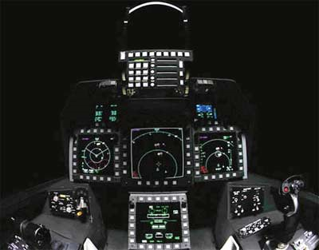
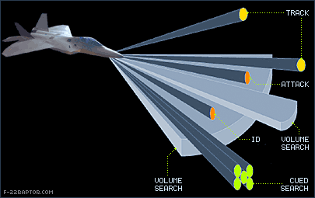
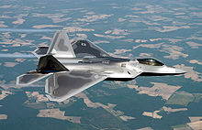
F-22 Raptor
LO Stealth
Supercruise (the ability to attain and sustain supersonic speeds w/o afterburners)
Agility (maneuverability for shoot-to-kill)
Advanced Avionics (integrated 4pi-steradian situation awareness)
Supportability (by means of higher reliability and 2 level maintenance)
AN/APG-77
Radar
Source: http://www.f-22raptor.com/af_radar.php
Wing Area: | 840 sq ft
Engine Thrust Class: | 35,000 lb
Level Speed: | 921 mph
Total Length: | 62.08 ft
Wing Span: | 44.5 ft
Horizontal Tail Span: | 29ft
Tail Span: | 18'10"
Total Height: | 16.67ft
Track Width: | 10.6ft
Engines: | Pratt & Whitney F-119
Max. Takeoff Weight: | 60,000 lb (27,216 kg)
Max. External Stores: | 5,000 lb (2,270 kg)
Weight Empty: | 31,670 lb (14,365 kg)
Ceiling: | 50,000 ft (15,240 m)
G Limit: | 9+
The F-22 Raptor is the world’s pre-eminent air dominance fighter
Source: http://www.f22fighter.com/
Notes:
The F-22 is the world’s pre-eminent air dominance fighter and provides the following capabilities:
LO Stealth
Supercruise (the ability to attain and sustain supersonic speeds w/o afterburners)
Agility (maneuverability for shoot-to-kill)
Advanced Avionics (integrated 4pi-steradian situation awareness)
Supportability (by means of higher reliability and 2 level maintenance

Slide 10
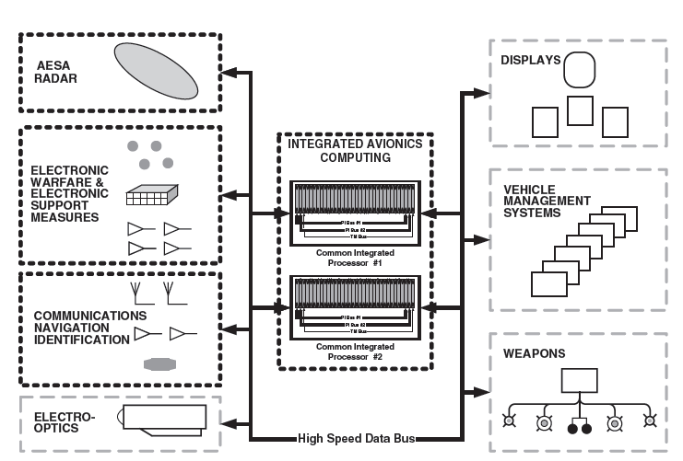

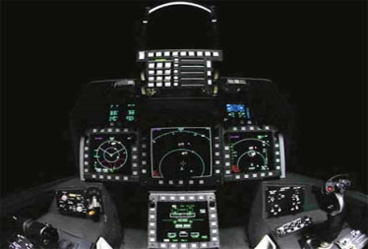
F-22 Avionics Architecture
8-12.5 GHz
Active ESA
10W TR modules
Low Observability
ECCM
LPI modes
AN/APG-77 RADAR
Highly sophisticated integrated avionics system architecture
Source: Military Avionics Systems, I. Moir and A. Seabridge
2006 John Wiley & Sons, Ltd
Notes:
The Hughes-built Common Integrated Processor (CIP) is the 'brain' of the avionics system. The CIP, which is quite literally the size of a oversized bread box, supports all signal and data processing for all sensors and mission avionics. There are two CIPs in each F-22, with 66 module slots per CIP. They have identical backplanes, and all of the F-22's processing requirements can be handled by only seven different types of processors. Currently, 19 of 66 slots in CIP 1 and 22 of 66 slots in CIP 2 are not in use and can be used for future growth. Each module is limited by design to only 75 percent of its capability, so the F-22 has thirty percent growth capability with no change to the existing equipment. There is space, power, and cooling provisions in the aircraft now for a third CIP, so the requirement for a 200 percent avionics growth capability in the F-22 can be met easily. CIP also contains mission software that uses tailorable mission planning data for sensor emitter management and multisensor fusion; mission-specific information delivered to system through Fairchild data transfer equipment that also contains mass storage for default data and air vehicle operational flight programme; General purpose processing capacity of CIP is rated at more than 700 million instructions per second (Mips) with growth to 2,000 Mips; signal processing capacity greater than 20 billion operations per second (Bops) with expansion capability to 50 Bops; CIP contains more than 300 Mbytes of memory with growth potential to 650 Mbytes.
Intra-flight data link automatically shares tactical information between two or more F-22s. Airframe contains provisions for IRST and side-mounted phased-array radar.

Slide 11
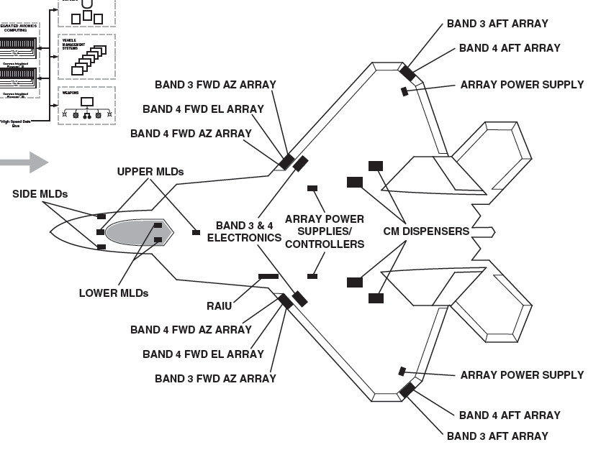
F-22 Avionics Architecture
8-12.5 GHz
Active ESA
10W TR modules
Low Observability
ECCM
LPI modes
AN/APG-77 RADAR
Highly sophisticated integrated avionics system architecture
Source: Military Avionics Systems, I. Moir and A. Seabridge
2006 John Wiley & Sons, Ltd
Notes:
The F-22 EW and ESM systems are many and varied. They are integrated into the F-22 to minimize RCS and maximize coverage and capability.

Slide 12
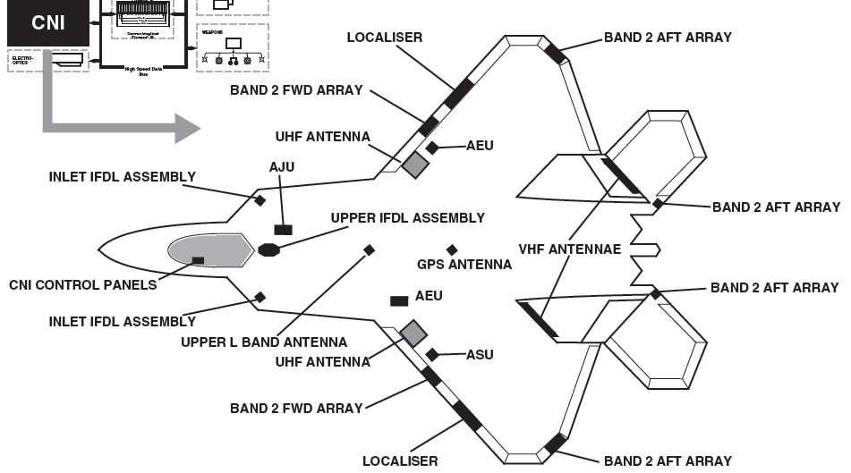
F-22 Avionics Architecture
8-12.5 GHz
Active ESA
10W TR modules
Low Observability
ECCM
LPI modes
AN/APG-77 RADAR
Highly sophisticated integrated avionics system architecture
Source: Military Avionics Systems, I. Moir and A. Seabridge
2006 John Wiley & Sons, Ltd
Notes:
The F-22 CNI capabilities are distributed throughout the aircraft.

Slide 13

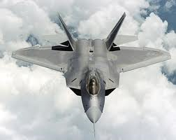
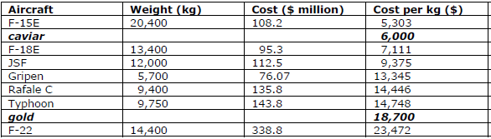
F-22 Acquisition
First flight,
preproduction
Sep 97
First flight,
production
Sep 03
Request for proposals
1985
Program Start
Oct 86
FOC
Dec 07
1981
Requirements issued
Sep 1990
First Flight
Aug 01
Production go-ahead
Dec 05
IOC
Jul 09
Production capped
at 187 Aircraft
Jul 1986
Design Submitted
World’s
most
expensive
World’s
best
Cost needs to be balanced with war fighting capability
  Acquisition, maintenance, and upgrades need to be cost competitive AND timely AND high quality
  Open avionics architecture are a fundamental enabler!
Sources:
Jane's All the World's Aircraft
Defense Aerospace.com; Measuring the Real Cost of Modern Fighter Aircraft
Notes:
The F22 took 25 years to develop and a kg of F22 costs more than a kg of gold, making the F22 the most expensive fighter in the world. The major message here is that cost needs to be balanced with war fighting capability; as we will discuss, acquisition, maintenance, and upgrades need to be cost competitive AND timely AND high quality. Open avionics architecture are a fundamental enabler!

Slide 14
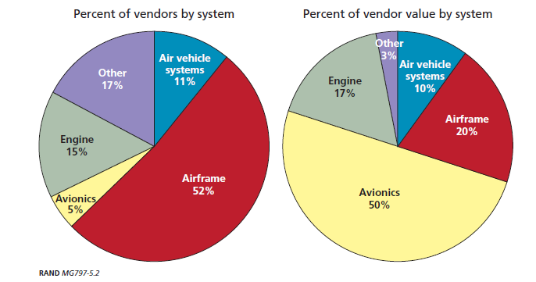
F-22 Supply-Chain Vendors
Source: Ending F-22A production: costs and industrial base implications of alternative options / Obaid Younosss … [et al]
Avionics supplied by a small set of vendors but are the major cost component in a modern fighter aircraft.
Notes:
Avionics are supplied by a small set of vendors but are the major cost component in a modern fighter aircraft.

Slide 15
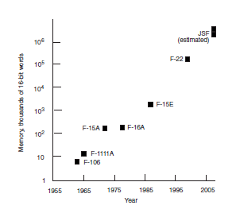
Growth in Operational Flight Program (OFP) Complexity
Aging Avionics in Military Aircraft
http://www.nap.edu/catalog/10108.html
F-35
(estimated)
10⁶
10⁵
F-22
Estimated 1.7M SLOC OFP
90% ADA
10⁴
OFP Memory Utilization: K – 16 bit words
F-15E
10³
10²
F-15A
F-16A
10
F-111A
F-106
1
1955 1965 1975 1985 1995 2005
Year
Modern software architectures, technologies, and practices are crucial as the complexity of military aircraft software systems continues to grow exponentially
Notes:
Modern software architectures, technologies, and practices are crucial as the complexity of military aircraft software systems continues to grow exponentially

Slide 16
Outline
Open Architecture Vision for the Air Force
  Layered architecture
  Technologies
Air Force Avionics Architectures
  F22 Raptor case study
  Architecture evolution
Open Avionics and Ground Segments
  Key open avionics concepts
  Architectures and testbeds
Acquisition in an Open Architecture Context
  Leverage and adapt
  “Open” acquisition
Conclusion
Notes:
Outline

Slide 17
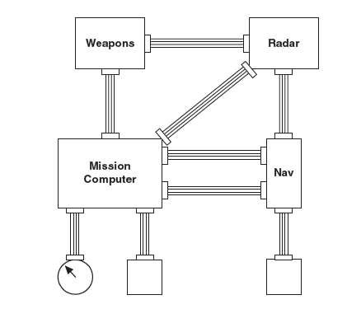
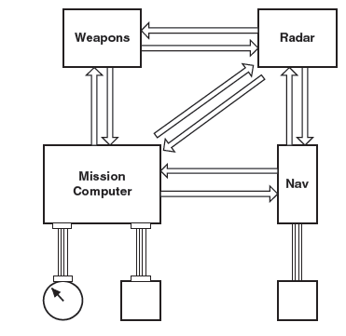
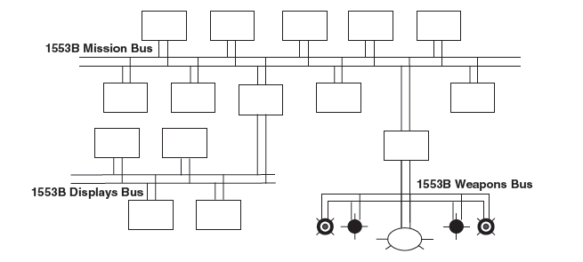
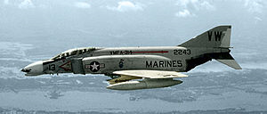
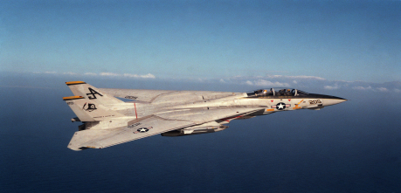
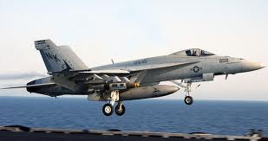
Early Avionics Architectures
Distributed Analog Architecture
Circa 1960s
Distributed Digital Architecture
Circa 1970s
Federated Digital Architecture
Circa 1980s
F-4 Phantom
F-14A Tomcat
F/A-18 Hornet
Source: Military Avionics Systems, I. Moir and A. Seabridge
2006 John Wiley & Sons, Ltd
Notes:
Avionics architectures have evolved over the 1960s to 1980s from distributed analogs systems to distributed digital systems with point-to-point interconnects, to federated digital systems with bus-like architectures and dedicated buses.

Slide 18
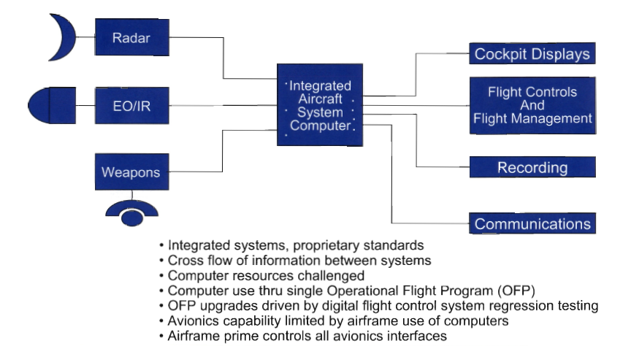
Current Operational Systems
1970s to 1990s
Radar
Cockpit Displays
Integrated Aircraft System Computer
Flight Controls & Flight Management
EO / IR
Weapons
Recording
Communications
Notes:
Current operational avionics architectures use an integrated aircraft system and proprietary standards. The Airframe prime controls all of the avionics interfaces.

Slide 19
F-22 Avionics Architecture
8-12.5 GHz
Active ESA
10W TR modules
Low Observability
ECCM
LPI modes
AN/APG-77 RADAR
Highly sophisticated capability based on integrated avionics system architecture
Source: Military Avionics Systems, I. Moir and A. Seabridge
2006 John Wiley & Sons, Ltd
Notes:
The F-22 avionics subsystem is an example of a highly sophisticated capability based on the integrated avionics system architecture.

Slide 20
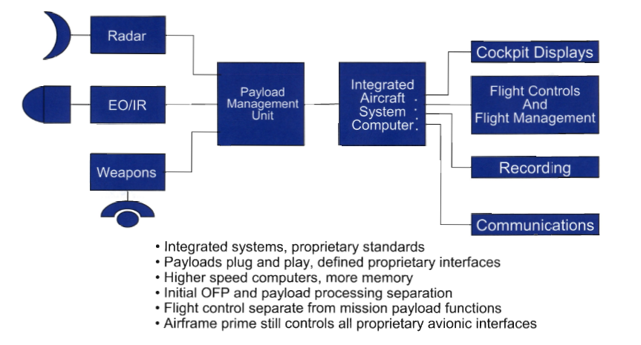
Evolving
1990s to 200X
Radar
Cockpit Displays
Payload Manage-ment Unit
Integrated Aircraft System Computer
EO / IR
Flight Controls & Flight Management
Weapons
Recording
Communications
Notes:
The segregation for payload management from integrated aircraft controls and displays represents a move towards a more federated architecture.

Slide 21
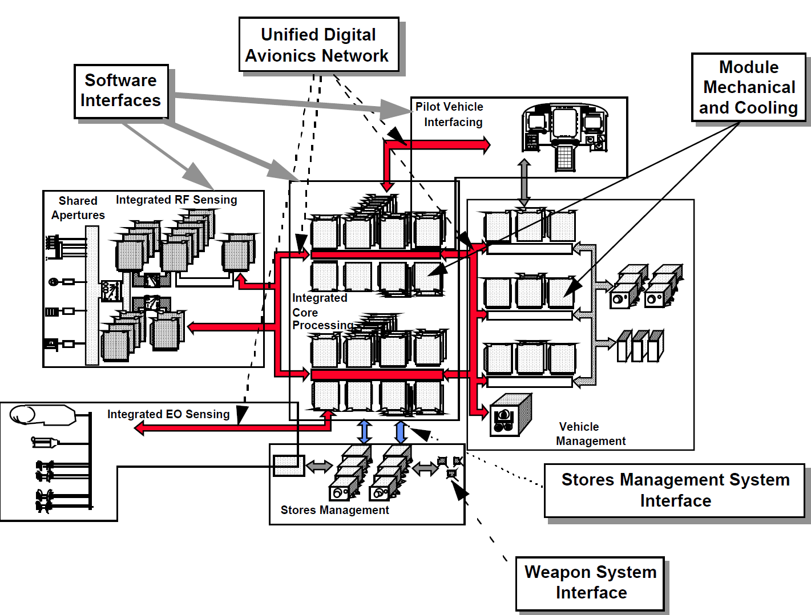
“PAVE PACE” Avionics Architecture
Extension of F22 integrated avionics system architecture
  Integrates RF sensing / management
  Unified avionics digital network based on commercial technologies
Notes:
The PAVE PACE architecture prototyped by AFRL serves as a template for the F35 avionics system. It extend the F22 integrated avionics system architecture by federating payload management from pilot vehicle interfaces (for example). Note how the RF sensing / management is separated into a federation of integrated subsystems that share antenna technologies. It also unifies the avionics digital network based on commercial technologies.

Slide 22
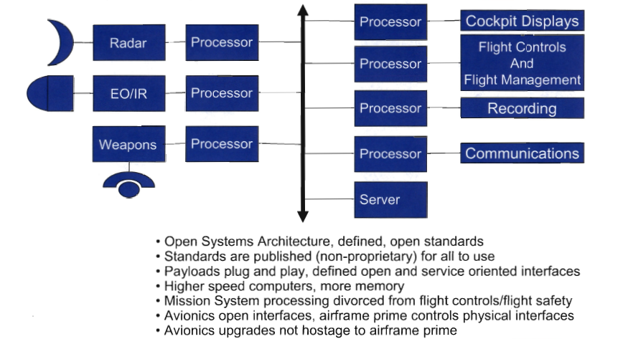
Open Architecture
201X - future
Processor
Cockpit Displays
Radar
Processor
Flight Controls & Flight Management
Processor
EO / IR
Processor
Processor
Recording
Weapons
Processor
Processor
Communications
Server
Notes:
The open avionics architecture of the future will look at first like the federated 1553 bus architectures of the 70s. The differences are really apparent, however, in the software architectures which will be based on SOA, on the plug-and-play nature of the avionics subsystem hardware, and the standard, open interfaces that will form the infrastructure to promote competitive procurement of avionics technology.

Slide 23
Outline
Open Architecture Vision for the Air Force
  Layered architecture
  Technologies
Air Force Avionics Architectures
  F22 Raptor case study
  Architecture evolution
Open Avionics
  Key open avionics concepts
  Architectures and testbeds
Acquisition in an Open Architecture Context
  Leverage and adapt
  “Open” acquisition
Conclusion
Notes:
Outline

Slide 24
Open Avionics
- Key Technologies -
Concept
Composable Open Reference Architectures
Plug-and-Play Hardware Infrastructure
Service-oriented Subsystems
Service-oriented Middleware
Service and Client Factorization
Avionics Metadata
Notes:
This slide identifies the key technology concepts embodied in an Avionics Open System Architecture.

Slide 25
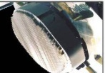

Open Avionics Architecture Elements
- Reference Functional Architecture -
Open Reference Architectures
Plug-and-Play Hardware
Service-oriented Subsystems
Service-oriented Middleware
Service & Client Factorization
Avionics Metadata
Radar
AMRAAM
System
EW
B
…
A
C
D
Mission
Computer
Mass Storage
Display
Subsystem
CNI
K
…
E
F
G
H
Interface Control Documents (ICD) define
  data items and messages
  protocols observed
  timing & event sequences
I
Network
Adapter/
DataLink
To/from GIG
(virtual Ground Station)
J
Notes:
An Avionics OSA starts with a reference functional architecture that identifies all key interfaces and modules. For an enterprise, there would be a set of components and their interfaces, a subset of which would be combined and specialized to define a specific architecture instantiation. For example, an F22 architecture could be a particular specialization. There could also be a series of F22 architectures (block upgrades) that are configuration managed. A key requirement for an open architecture is the set of Interface Control Documents that define all of the open interfaces.

Slide 26
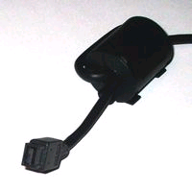
Open Avionics Architecture Elements
- Standard Plug and Play Hardware -
Open Reference Architectures
Plug-and-Play Hardware
Service-oriented Subsystems
Service-oriented Middleware
Service & Client Factorization
Avionics Metadata
Radar
AMRAAM
System
EWS
B
…
A
C
D
Switched fabric
Mil Std 1394B
(or Mil Std 1553)
Mission
Computer
Mass Storage
Display
Subsystem
CNI
K
…
E
F
G
H
ATR Chassis
I
Self-describing components for self-organization (crucial for composable architecture).
Network
Adapter/
DataLink
J
To/from GIG
SEM-E Module
Notes:
An architecture must be built from actual hardware components. The enable interoperability and also component reuse/ sharing, standards for plug-and-play hardware are needed. The chart shows multiple interconnect technologies– the long-standing 1553 bus and switched-fabric interconnects are the examples shown. The components that are plugged into these interconnects must be self-describing to the rest of the system, so that other components can “look-up” how to exchange (meta) data with each component as it is inserted.

Slide 27
Open Avionics Architecture Elements
- Service Oriented Subsystem Interfaces -
Open Reference Architectures
Plug-and-Play Hardware
Service-oriented Subsystems
Service-oriented Middleware
Service & Client Factorization
Avionics Metadata
Reference Interfaces
Executable Service Interfaces
Radar
AMRAAM
System
EWS
B
…
A
C
D
A
C
D
Mission
Computer
Mass Storage
Display
Subsystem
CNI
K
…
E
F
G
H
E
F
G
H
I
I
Network
Adapter/
DataLink
Avionics performance constraints require domain-specific service / client technologies
J
To/from GIG
(virtual Ground Station)
J
Notes:
Once the reference architecture and hardware standards have been established, the next step is to re-define each interface as a set of services and clients. Using an approach similar to the WSDL (web service description language), interfaces can be rigorously defined, accessed by executable code, and used by clients to access services. In a sense, the ICDs are thereby captured in executable service interfaces and client bindings to these interfaces.

Slide 28
Open Avionics Architecture Elements
- Middleware -
Open Reference Architectures
Plug-and-Play Hardware
Service-oriented Subsystems
Service-oriented Middleware
Service & Client Factorization
Avioincs Metadata
SOA middleware is:
  Communication middleware (e.g. DDS pub/sub)
  Registry/Broker
  Interface description language
  Common services
Radar
AMRAAM
System
EWS
B
…
A
C
D
A
C
D
Avionics SOA Middleware
Mission
Computer
Mass Storage
Display
Subsystem
CNI
K
…
E
F
G
H
E
F
G
H
I
I
SOA middleware supports:
  Position independent services and clients
  Real-time communication*
Network
Adapter/
DataLink
J
To/from GIG
(virtual Ground Station)
J
* Domain optimized (not SOAP; maybe DDS)
Notes:
To enable services and clients to interact, a service oriented middleware is needed. The middleware provide communication capabilities (messaging), provides a registry and/ or broker to allow services to register their interfaces and to allow clients to access the interfaces (which also tell the clients how to invoke the service.) Common services and client applications can be embedded in the middleware, thus standardizing common capabilities. The SOA middleware should provide for position independent services and clients, and also needs to provide low latency, high throughput real-time communications. A service bridge to the enterprise SOA (e.g. ground stations and other GIG enabled users) is also needed.

Slide 29
Open Avionics Architecture Elements
- Service/Client Decomposition -
Open Reference Architectures
Plug-and-Play Hardware
Service-oriented Subsystems
Service-oriented Middleware
Service & Client Factorization
Avionics Metadata
Define standard behavior of subsystem services
Subsystem implementations hidden from outside world
  Wrapper for legacy systems
  Embedded OSA details hidden
Radar
AMRAAM
System
EWS
B
…
A
C
D
A
C
D
Avionics SOA Middleware
Mission
Computer
Mass Storage
Display
Subsystem
CNI
K
…
E
F
G
H
E
F
G
H
Mission Computer Software
  Factored into services and clients
  Services mappable anywhere in system
  Service internals are legacy codes of new variants
I
I
Network
Adapter/
DataLink
J
To/from GIG
(virtual Ground Station)
J
Notes:
Once the service oriented infrastructure is in place, the avionics systems functionality needs to be decomposed as a set or services and clients (applications). Program can be both clients and services (peer-to-peer relationship with other programs that are clients and services). To facilitate interoperability, the basic behavior of all clients and services needs to be defined and standardized. Thus, the protocols for entering or exiting the system, for supporting system-level or component level tests, for fault tolerance and isolation, authentication, etc. can be standardized across the avionics domain. Legacy subsystems can be wrapped in service and client interfaces that mediate between the SOA and the internal details of the subsystems. For large code bases, such as what one might find in a centralized Mission Computer, the code should be factored into services and clients. The position of these services and clients can be specified at runtime with mapping files. An efficient mapping, of course, would be required to ensure that performance requirements can be met. The power in this service-oriented, position independent factorization is that code can be readily ported to new processor technology as needed, changes can be better isolated to improve regression testing, centralized, monolithic codes can be decentralized and distributed (and distributed codes can be grouped – centralized –when performance dictates).

Slide 30
Open Avionics Architecture Elements
- Metadata Definition -
Open Reference Architectures
Plug-and-Play Hardware
Service-oriented Subsystems
Service-oriented Middleware
Service & Client Factorization
Avionics Metadata
Metadata specifications describe
  Message contents
  Data products
  Avionics system configuration
Radar
AMRAAM
System
EWS
B
…
A
C
D
A
C
D
Avionics SOA Middleware
Mission
Computer
Mass Storage
Display
Subsystem
CNI
K
…
E
F
G
H
E
F
G
H
Avionics Metadata Stores
Physical configuration/status descriptions
Metadata catalogs for all data product stores
I
I
Network
Adapter/
DataLink
J
To/from GIG
(virtual Ground Station)
J
Notes:
Metadata is an important aspect in the overall avionics OSA.

Slide 31
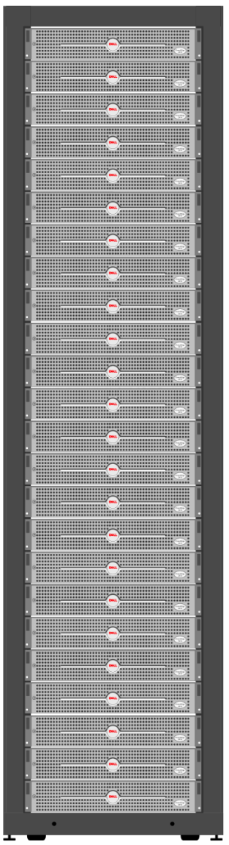
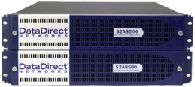

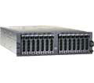
Open Architecture Testbed
- OA Testing -
Service Nodes
Environment
Simulation
Shared
network
storage
Radar
AMRAAM
System
EWS
B
…
A
C
D
A
C
D
Avionics SOA Middleware
resource manager
Mission
Computer
Mass Storage
Display
Subsystem
CNI
E
F
…
E
F
G
H
Web Server
G
H
I
I
Network
Adapter/
DataLink
To LAN
Control and Display
Simulate subsystem interfaces
Uses open avionics standards
Key:
Simulation
Cluster
Actual
Notes:
The avionics software testbed can initially be hosted by a standard Linux-based cluster.

Slide 32
Open Architecture Testbed
- OA Testing -
Service Nodes
Environment
Simulation
Shared
network
storage
Environment
Simulations
Radar
AMRAAM
System
EWS
Radar
B
…
A
C
D
A
C
D
AMRAAM
Avionics SOA Middleware
resource manager
EWS
Mission
Computer
Mass Storage
Display
Subsystem
CNI
Mission
Computer
…
E
F
G
H
Web Server
Mass Storage
E
F
G
H
Display
Subsystem
I
I
CNI
Network
Adapter/
DataLink
To LAN
Network
Adapter
Control and Display
Control/
Display
Simulate subsystem interfaces
Uses open avionics standards
Key:
Simulation
Cluster
Actual
Notes:
The simulated subsystem (interfaces) and the overall testbed infrastructure will map onto a set of cluster nodes.

Slide 33
Open Architecture Testbed
- Operational Code Development -
Service Nodes
Environment
Simulation
Shared
network
storage
Environment
Simulations
Radar
AMRAAM
System
EWS
Radar
B
…
A
C
D
A
C
D
AMRAAM
Avionics SOA Middleware
resource manager
EWS
Mission
Computer
Mass Storage
Display
Subsystem
CNI
Mission
Computer
…
E
F
G
H
Web Server
Mass Storage
E
F
G
H
Display
Subsystem
I
I
CNI
Network
Adapter/
DataLink
To LAN
Network
Adapter
Control and Display
Control/
Display
Factor Mission Computer Operation Flight Program (OFP) into Services and Clients
Develop new OFP software
Test interface compliance
Key:
Simulation
Cluster
Actual
Notes:
The testbed can serve as an environment to develop operational code. The code interfaces and hence a key aspect of integration will thereby be verified early in the development.

Slide 34
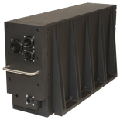
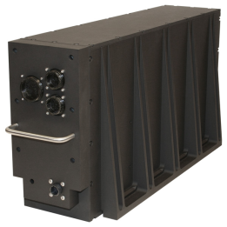
Open Architecture Testbed
- Selective Build Out -
Service Nodes
Radar I/Fs
Radar Sim
Environment
Simulation
Radar Sim
B
Shared
network
storage
Environment
Simulations
Radar
AMRAAM
System
EWS
Bus Interfaces
…
A
C
D
A
C
D
AMRAAM
Avionics SOA Middleware
resource manager
EWS
Mission
Computer
Mass Storage
Display
Subsystem
CNI
Bus Interfaces
…
E
F
G
H
Web Server
Mass Storage
E
F
G
H
Display
Subsystem
I
I
CNI
Network
Adapter/
DataLink
To LAN
Network
Adapter
Control and Display
Control/
Display
Key:
Simulation
Cluster
Actual
Notes:
Other subsystems can also be integrated into the testbed, so that specific testbed variants focused on particular subsystem developments can be stood up at different facilities or as new capabilities become available.

Slide 35
Outline
Open Architecture Vision for the Air Force
  Layered architecture
  Technologies
Air Force Avionics Architectures
  F22 Raptor case study
  Architecture evolution
Open Avionics
  Key open avionics concepts
  Architectures and testbeds
Acquisition in an Open Architecture Context
  Leverage and adapt
  “Open” acquisition
Conclusion
Notes:
Outline

Slide 36
Historical Approach
Government PO
Down select based on study, not demonstrated performance
No competitive incentive after prime contractor down select
Business model locks prime / sub for life of program
Government passes subsystem performance responsibility to prime
All interfaces proprietary to prime / sub
Business model locks improvements to initial prime / sub relationship
Expensive upgrades captive to prime subsystem contractors
Lack of competition deters contractor risk reduction / enhancement investment
Prime Contractor
Proposal A
Proposal B
Paper Down Select
Prime conducts downselect
PDR
CDR
Flight Test
Single Design
Prime Production Decision
Prime / Sub System
Changes
Ops Test and Ops
Upgrades
De-Mil
Notes:
Lack of competition leads to complacency and lower quality, more expensive DoD acquisition and lifecycle costs.

Slide 37
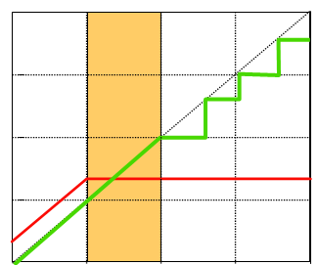
Open Systems Support
“Leverage Adapt” Strategy
Design freeze
Deployment
10,000
“Leverage & adapt”
1000
Good for rapidly changing technology
Good for rapidly changing requirements
Built-in refresh and improvements
More difficult to manage
Freezes technology and builds to fixed design
Acceptable for slow moving technologies
Requires stable requirements throughout lifecycle
Easier to manage with current acquisition strategy
Moore’s Law
Technology
Refresh
100
Processing Power
COTS with
portable software
“Freeze & build”
10
Custom Hardware
1
0
5
10
15
Years
Open Systems support “leverage and adapt” strategy; allows DoD to leverage
commercial industry’s investment
Continuous upgrade/refresh possible to meet evolving threats and obsolescence
Notes:
37
Open Systems support “leverage and adapt” strategy; this allows the DoD to leverage commercial industry’s investment. Continuous upgrade/refresh is then made possible to meet evolving threats and obsolescence.

Slide 38
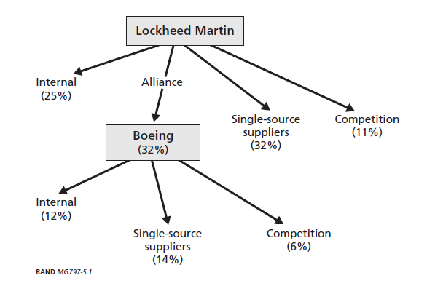
Need for Competitive Procurement
- E.G. F-22 Industrial Base -
Source: Ending F-22A production: costs and industrial base implications of alternative options / Obaid Younosss … [et al]
Competition restricted to less complex items
Little “IP” competition
Need to change competitive posture of military aircraft industrial base:
  → Competitive procurement and upgrade of components with high “Intellectual Property” content.
Notes:
The DoD needs to change competitive posture of the military aircraft industrial base: this implies the need for competitive procurement and upgrade of components with high “Intellectual Property” content.

Slide 39
Open Architecture Approach
Down select based on demonstrated performance (fly before buy)
Competitive incentive through flight test and production decision
Business model keeps competitive second source for life of program
Government maintains responsibility for subsystem until directed sub-integration
All interfaces collaboratively designed, verified and published
Business model support competitive spiral improvements
Less Expensive competitive upgrades independent of prime
Competition inspires contractor risk reduction / enhancement investment
Government PO
Avionics Prime Contractor
Avionics Prime Contractor
Proposal B
PDR
CDR
Flight Test
Proposal A
Design A
Best-of-breed
ICD Development and Verification Process
Design B
PDR
CDR
Flight
Test
Performance Down Select
Gov’t Downselect Product Decision
Directed Integration (Sub)
System Change
Ops Test & Ops
Upgrades
De-Mil
Notes:
The key is to create and maintain an environment where vendors can compete through the entire acquisition and afterwards.

Slide 40
Outline
Open Architecture Vision for the Air Force
  Layered architecture
  Technologies
Air Force Avionics Architectures
  F22 Raptor case study
  Architecture evolution
Open Avionics
  Key open avionics concepts
  Architectures and testbeds
Acquisition in an Open Architecture Context
  Leverage and adapt
  “Open” acquisition
Conclusion
Notes:
Outline

Slide 41
Conclusion
The Air Force is pursuing a layered open-architecture vision to improve system (of systems) capabilities in a cost effective and rapid manner.
Open avionics are crucial to enabling the competitive, cost effective, and timely introduction of new war-fighting capabilities in platforms that will persist for decades.
Service oriented concepts judiciously combined with embedded open system techniques will deliver the next generation of open avionics technologies and architectures.
Open architecture test beds based on executable specifications will accelerate avioincs integration and provide the mechanism to compete new avionics technologies.
Notes:
The Air Force is pursuing a layered open-architecture vision to improve system (of systems) capabilities in a cost effective and rapid manner.
Open avionics are crucial to enabling the competitive, cost effective, and timely introduction of new war-fighting capabilities in platforms that will persist for decades. Service oriented concepts judiciously combined with embedded open system techniques will deliver the next generation of open avionics technologies and architectures. Open architecture test beds based on executable specifications will accelerate avioincs integration and provide the mechanism to compete new avionics technologies.

